Slide 1
Complex numbers and quadratic equations
Shreyas M
B.Tech in ECE PES University Bangalore

Slide 2
Chapter map
Section | Topic
1 | Introduction
2 | Expression
3 | Axioms and properties
4 | Algebra of complex numbers in cartesian form
5 | Arg-and plane
6 | Polar form of complex numbers
6 | Quadratic equation
7 | Supplement (Hyperbolic functions)

Slide 3
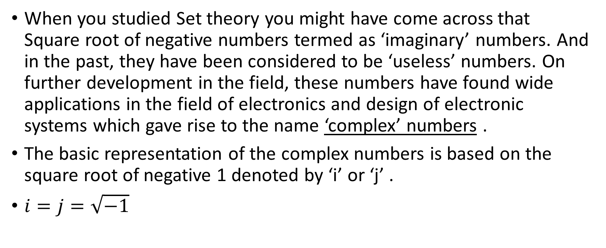
1 Introduction
When you studied Set theory you might have come across that Square root of negative numbers termed as ‘imaginary’ numbers. And in the past, they have been considered to be ‘useless’ numbers. On further development in the field, these numbers have found wide applications in the field of electronics and design of electronic systems which gave rise to the name ‘complex’ numbers .
The basic representation of the complex numbers is based on the square root of negative 1 denoted by ‘i’ or ‘j’ .
$i=j=\sqrt{−1}$

Slide 4
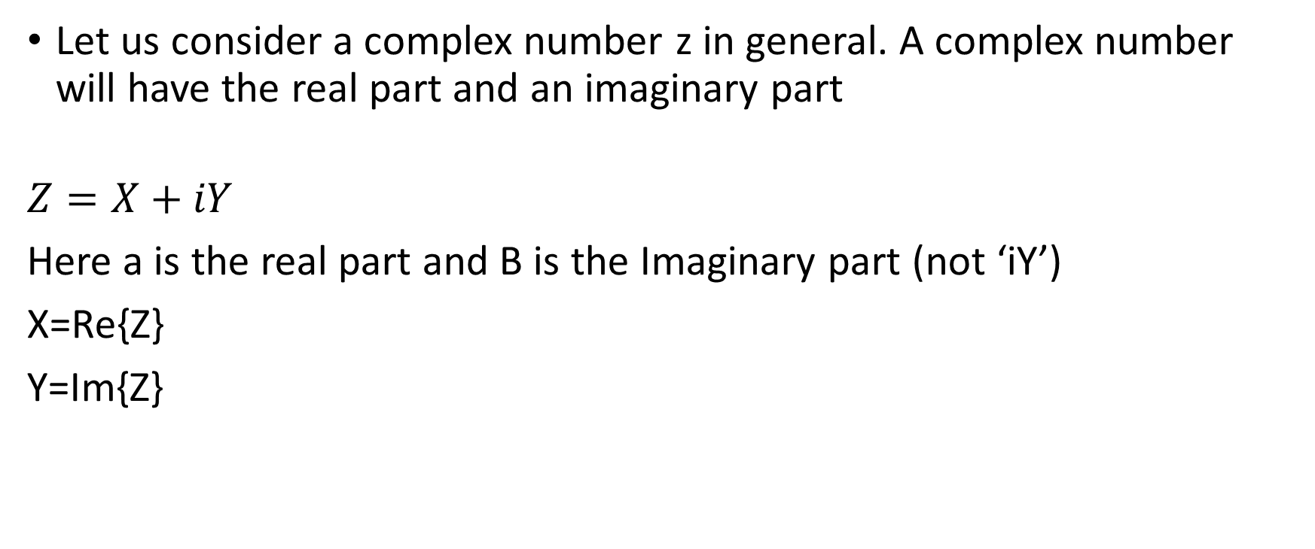
2 Expression
Let us consider a complex number z in general. A complex number will have the real part and an imaginary part
$$Z=X+iY$$
Here a is the real part and B is the Imaginary part (not ‘iY’)
X=Re{Z}
Y=Im{Z}

Slide 5
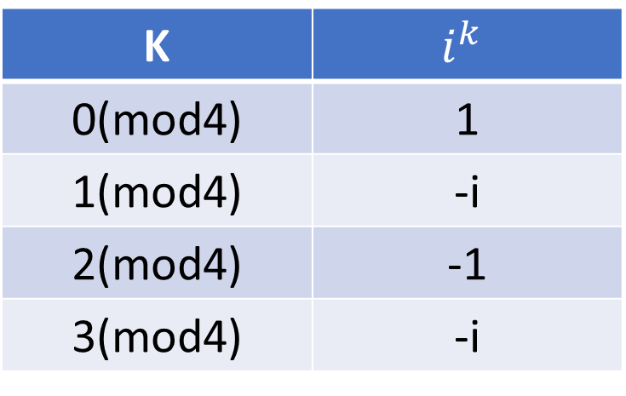

3 Axioms and properties
For all future concepts in complex numbers, we require a few assumptions to make our calculations easier. Supposing we need to calculate a power i to some large number. Lets say, $i^{k}$. It becomes easy knowing the following table based on what form the power is of.
K | $$i^{k}$$
0(mod4) | 1
1(mod4) | -i
2(mod4) | -1
3(mod4) | -i

Slide 6
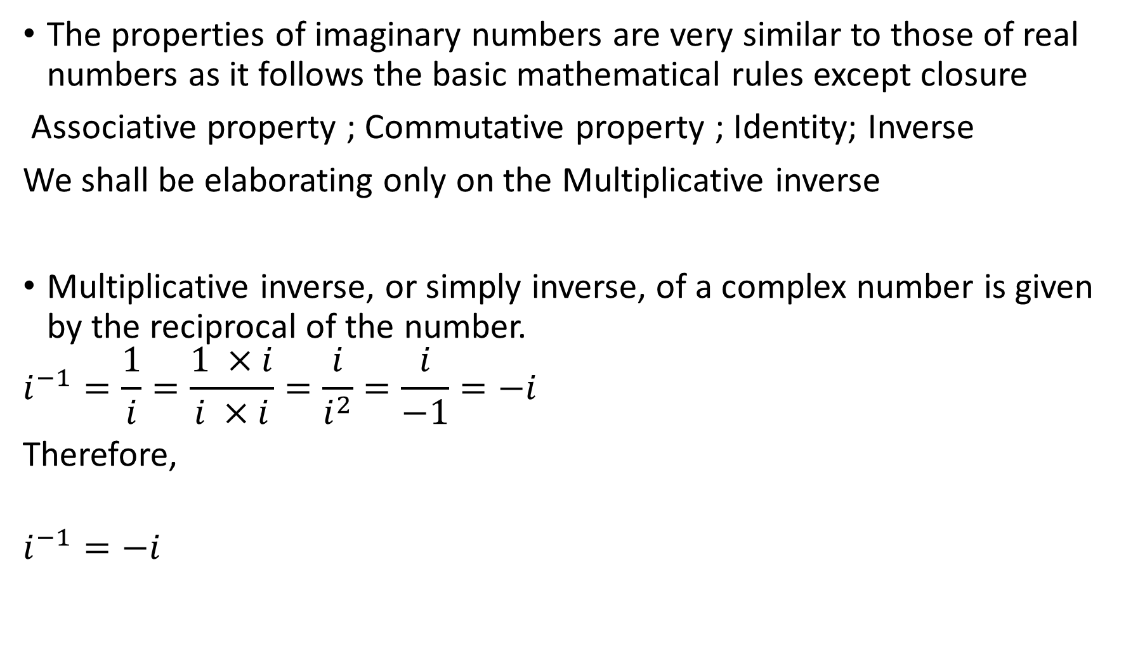
The properties of imaginary numbers are very similar to those of real numbers as it follows the basic mathematical rules except closure
Associative property ; Commutative property ; Identity; Inverse
We shall be elaborating only on the Multiplicative inverse
Multiplicative inverse, or simply inverse, of a complex number is given by the reciprocal of the number.
$$i^{−1}=\frac{1}{i}=\frac{1 ×i}{i ×i}=\frac{i}{i^{2}}=\frac{i}{−1}=−i$$
Therefore,
$$i^{−1}=−i$$

Slide 7
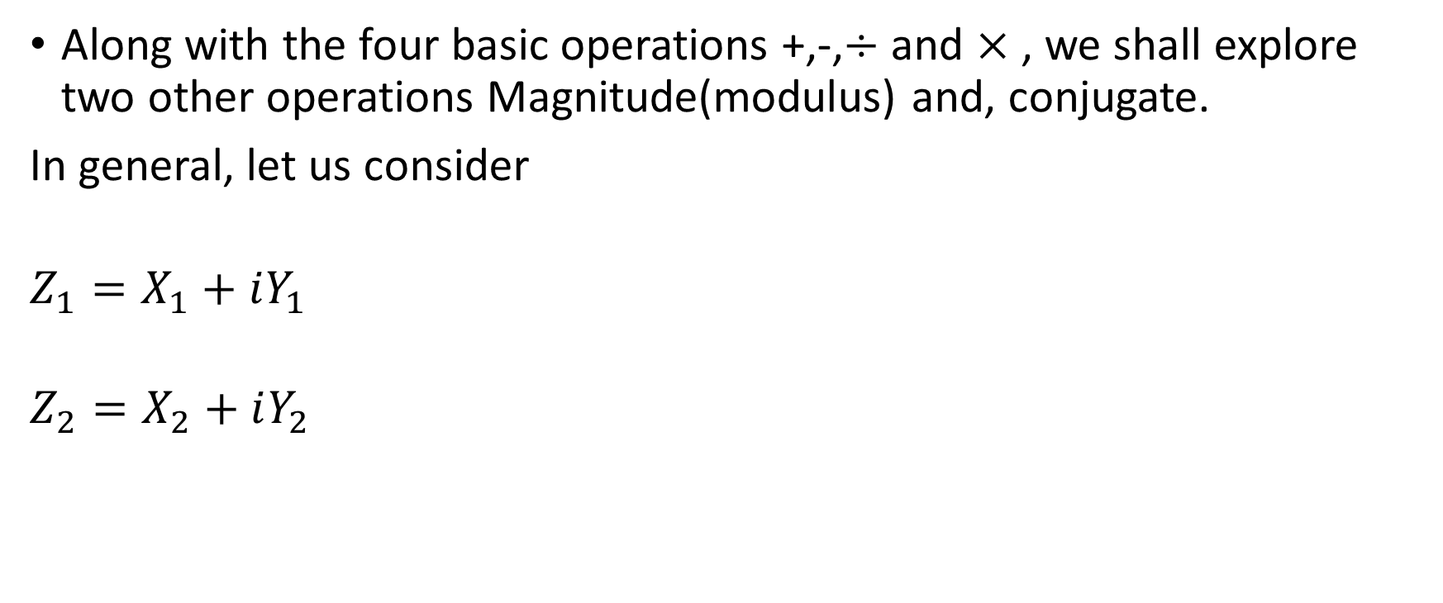
4 Algebra of Complex numbers
Along with the four basic operations +,-,$÷$ and $×$ , we shall explore two other operations Magnitude(modulus) and, conjugate.
In general, let us consider
$$Z_{1}=X_{1}+iY_{1}$$
$$Z_{2}=X_{2}+iY_{2}$$

Slide 8
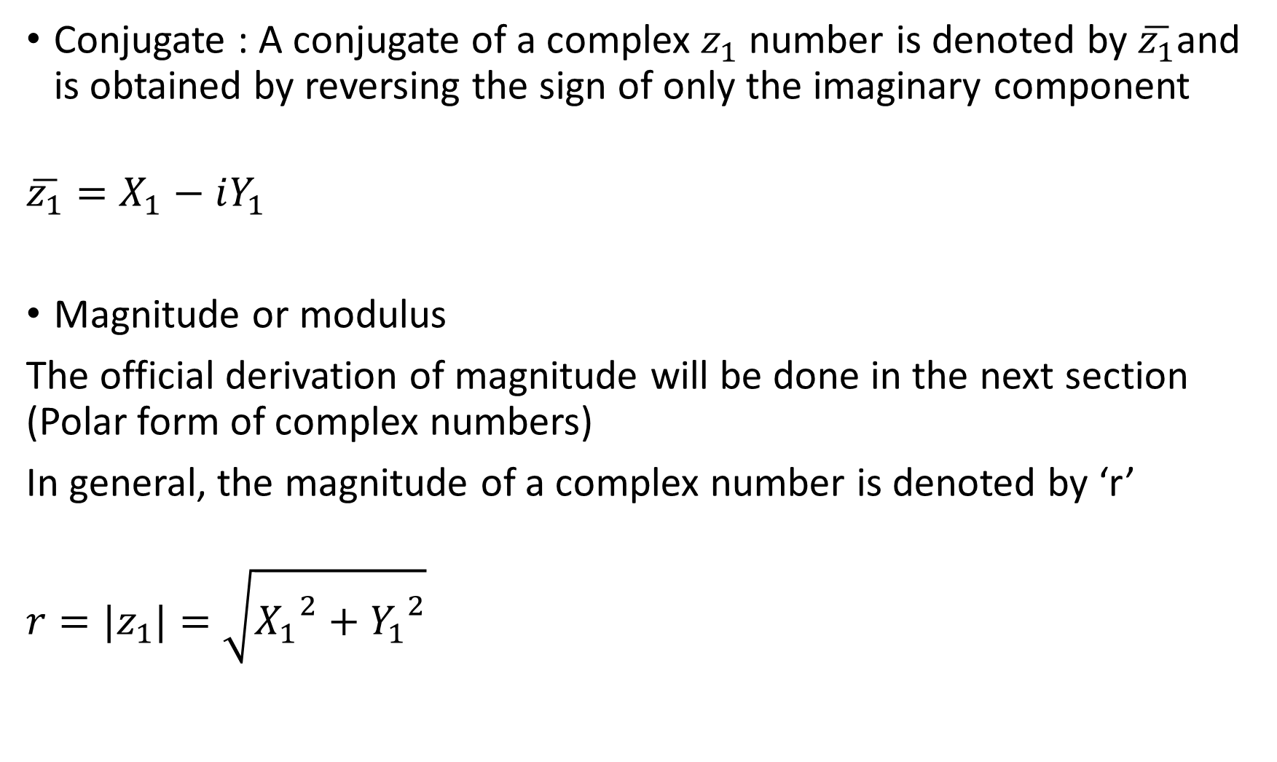
Conjugate : A conjugate of a complex $z_{1}$ number is denoted by $\overline{z_{1}}$and is obtained by reversing the sign of only the imaginary component
$$\overline{z_{1}}=X_{1}−iY_{1}$$
Magnitude or modulus
The official derivation of magnitude will be done in the next section (Polar form of complex numbers)
In general, the magnitude of a complex number is denoted by ‘r’
$$r=|z_{1}|=\sqrt{{X_{1}}^{2}+{Y_{1}}^{2}}$$

Slide 9
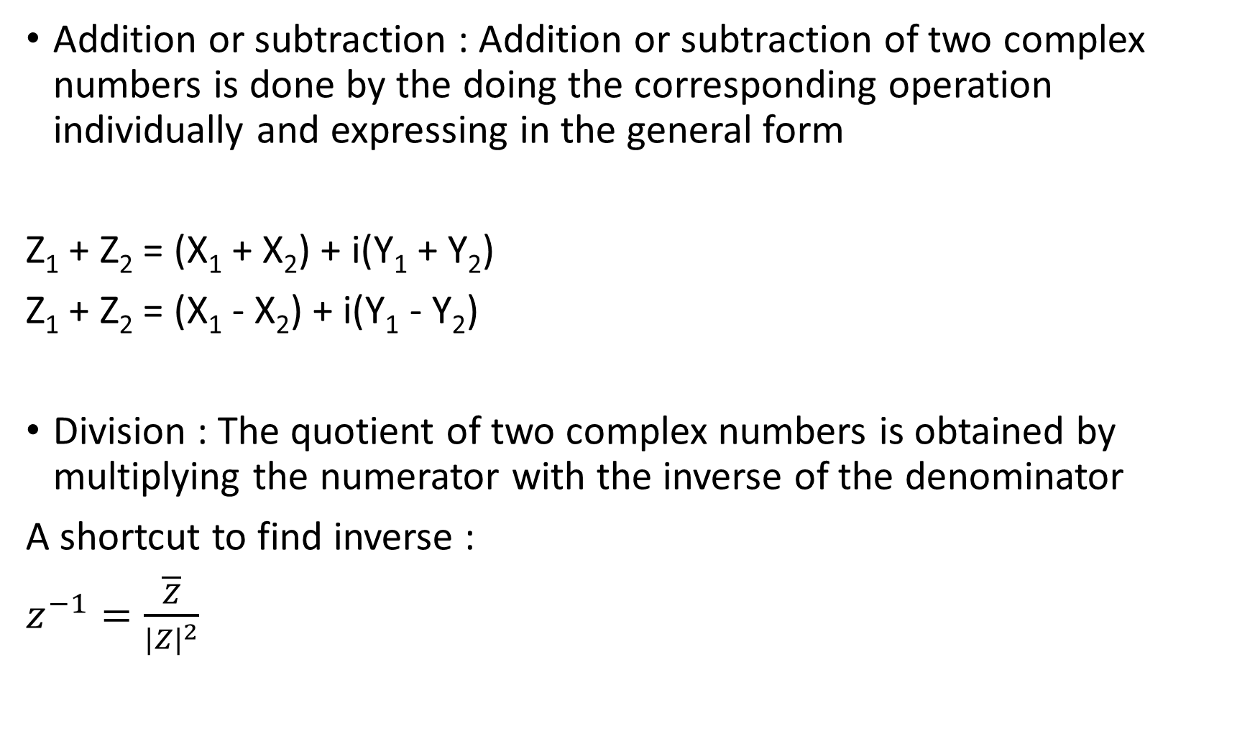
Addition or subtraction : Addition or subtraction of two complex numbers is done by the doing the corresponding operation individually and expressing in the general form
Z₁ + Z₂ = (X₁ + X₂) + i(Y₁ + Y₂)
Z₁ + Z₂ = (X₁ - X₂) + i(Y₁ - Y₂)
Division : The quotient of two complex numbers is obtained by multiplying the numerator with the inverse of the denominator
A shortcut to find inverse :
$z^{−1}=\frac{\overline{Z}}{{|Z|}^{2}}$
🔍Try proving through rationalization (multiplying numerator and denominator by conjugate)

Slide 10
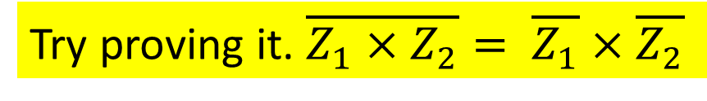
Multiplication : For this, the two complex numbers are treated as sum-of-terms form
Z₁ X Z₂ =(X₁+iY₁) X (X₂+iY₂)
Z₁ X Z₂ =X₁X₂ + iX₁Y₂ + iY₁X₂ + i²Y₁Y₂
Z₁ X Z₂ =(X₁X₂ - Y₁Y₂ ) + i(X₁Y₂+Y₁X₂)
A very useful property to be noted is
“Product of conjugate of complex numbers is conjugate of product of the same complex numbers”
🔍
Try proving it. $\overline{Z_{1}×Z_{2}}= \overline{Z_{1}}×\overline{Z_{2}}$

Slide 11
5 Arg-and plane/Complex plane/Polar plane
The Arg-and plane is the graphical form of representing a complex number
In the Arg-and plane , we can represent the complex number through two forms. What we have seen so far is the cartesian form. Another way to represent is the polar form.
In further slides, we will be discussing the polar form and the interconversion between the two forms

Slide 12
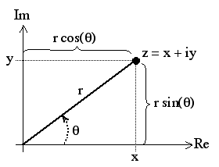
Representation of a complex number on the Arg-and plane:
To represent a complex number on the Arg-and plane, we first consider that the y-axis represents Im{z} and x-axis represents the Re{z}.
Every point on the Arg-and plane represents a distinct complex number.

Slide 13


Polar form:
Let us consider a point P(x,y) which represents a complex number Z=X+iY
Joining the origin O with P, will have length r
By Pythagoras theorem,
$$r=\sqrt{x^{2}+y^{2}}$$
$$\tan\left(θ\right)=\frac{PQ}{QO}=\frac{y}{x}$$
But
Y=r.sin$\left(θ\right)$
X=r.cos$\left(θ\right)$
Z= Rcos$\left(θ\right)$ + i Rsin$\left(θ\right)$
= R.[cos$\left(θ\right)$ + i sin$\left(θ\right)$]
= Re^{i}$θ$
Z= Re^{i}$θ$ [or represented as Z(R,$θ$) ]
This itself is the polar form of the complex number. R is called the magnitude and $θ$ is called the phase. It is also called the ‘Argument of the complex number’ denoted by Arg(z)

Slide 14
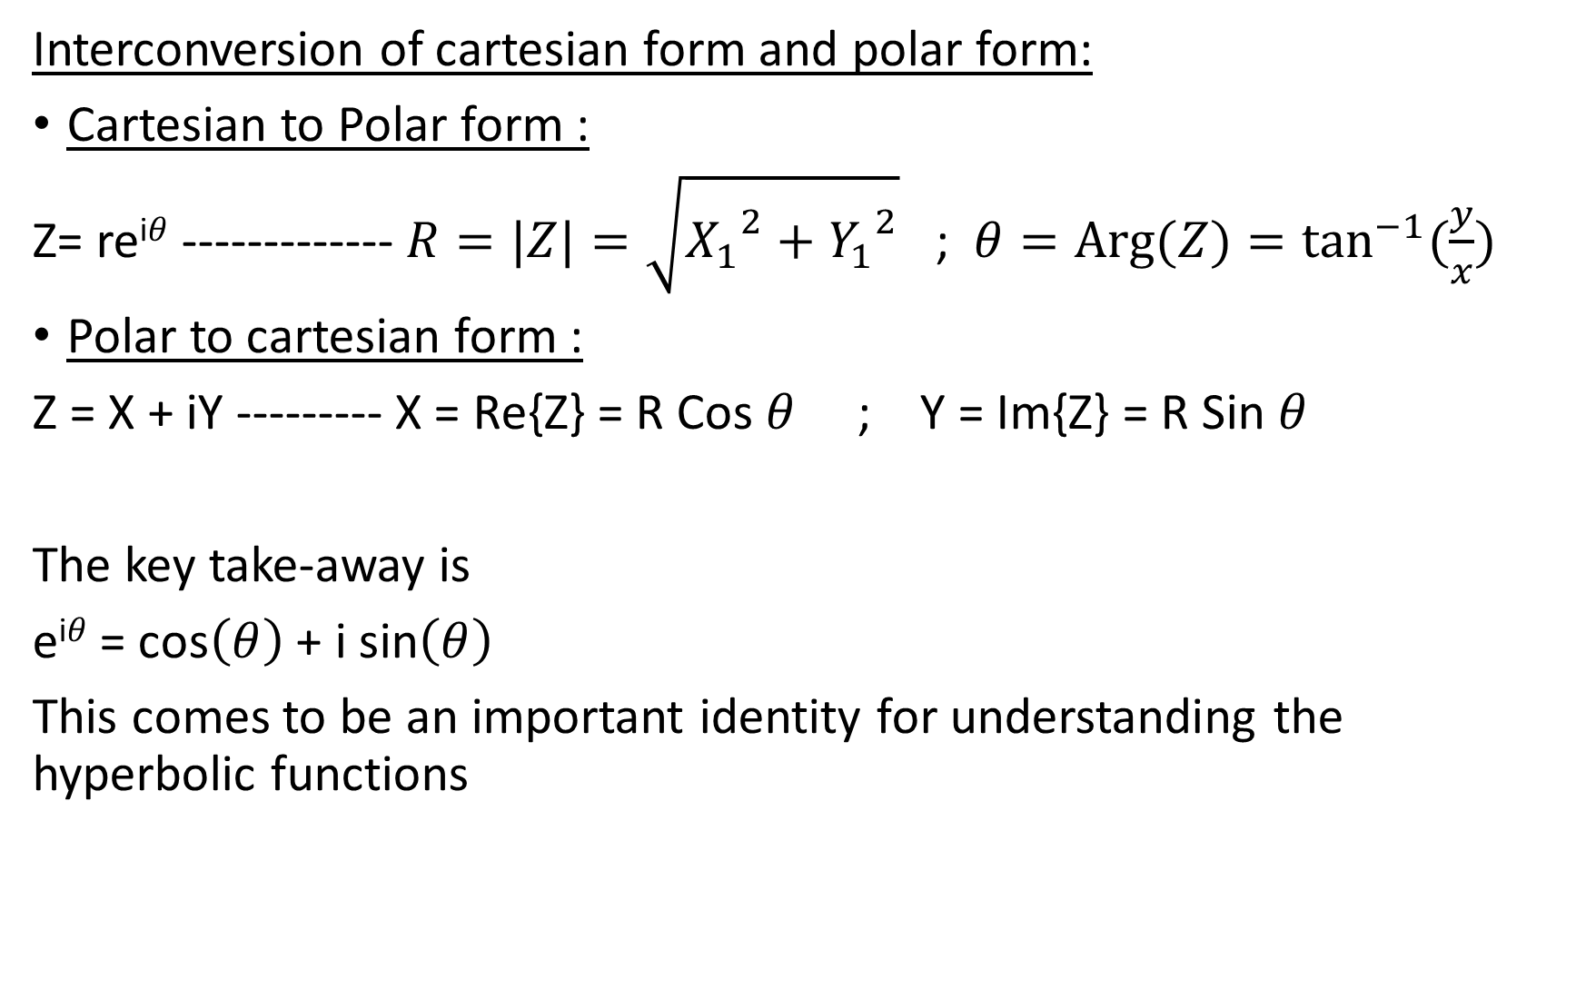
Interconversion of cartesian form and polar form:
Cartesian to Polar form :
Z= re^{i}$θ$ ------------- $R=|Z|=\sqrt{{X_{1}}^{2}+{Y_{1}}^{2}}$ ; $θ=Arg⁡(Z)=\tan^{−1}{(\frac{y}{x})}$
Polar to cartesian form :
Z = X + iY --------- X = Re{Z} = R Cos $θ$ ; Y = Im{Z} = R Sin $θ$
The key take-away is
e^{i}$θ$= cos$\left(θ\right)$ + i sin$\left(θ\right)$
This comes to be an important identity for understanding the hyperbolic functions

Slide 15
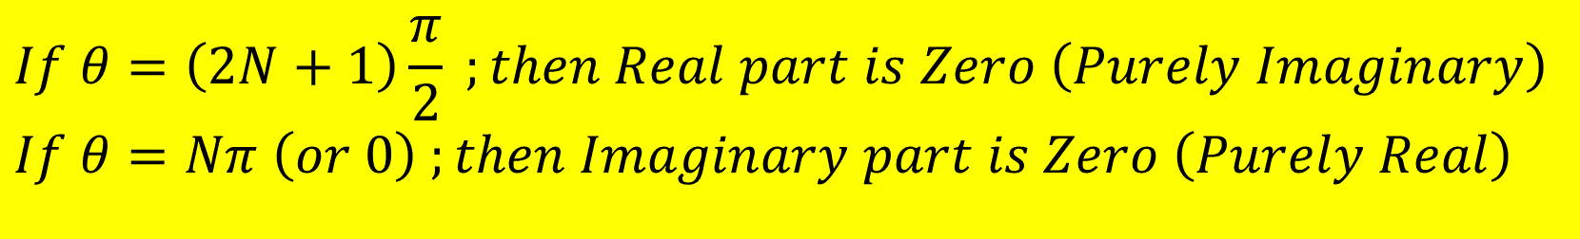
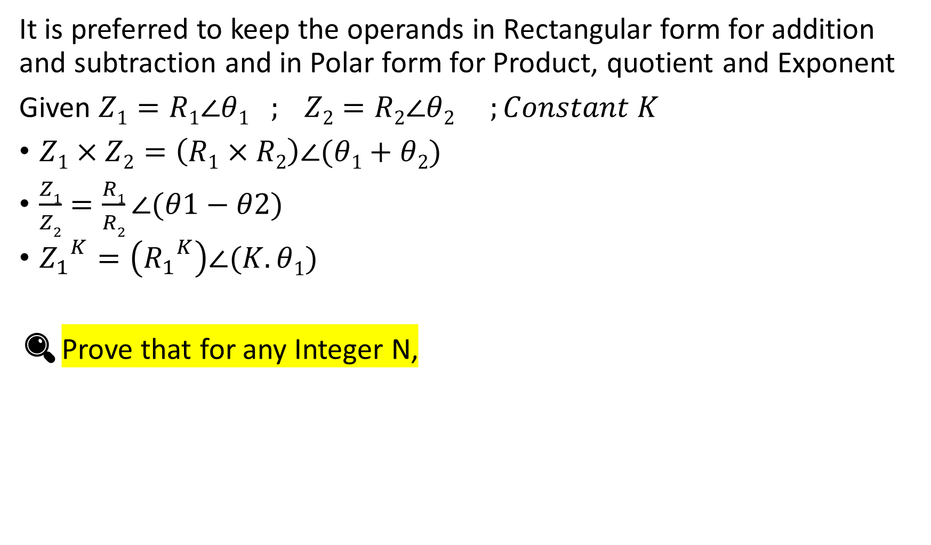
It is preferred to keep the operands in Rectangular form for addition and subtraction and in Polar form for Product, quotient and Exponent
Given $Z1=R1∠θ1 ; Z2=R2∠θ2 ;Constant K$
$Z1×Z2=\left(R1×R2\right)∠(θ1+θ2)$
$\frac{Z1}{Z2}=\frac{R1}{R2}∠(θ1−θ2)$
${Z_{1}}^{K}=\left({R_{1}}^{K}\right)∠(K.θ1)$
🔍Prove that for any Integer N,
$$If θ=\left(2N+1\right)\frac{π}{2} ;then Real part is Zero \left(Purely Imaginary\right)$$
$$If θ=Nπ \left(or 0\right) ;then Imaginary part is Zero \left(Purely Real\right)$$

Slide 16
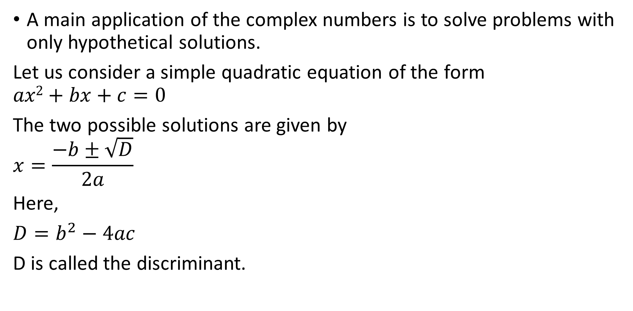
6 Quadratic Equation
A main application of the complex numbers is to solve problems with only hypothetical solutions.
Let us consider a simple quadratic equation of the form
$$ax2+bx+c=0$$
The two possible solutions are given by
$$x=\frac{−b±\sqrt{D}}{2a}$$
Here,
${D=b}^{2}−4ac$
D is called the discriminant.

Slide 17
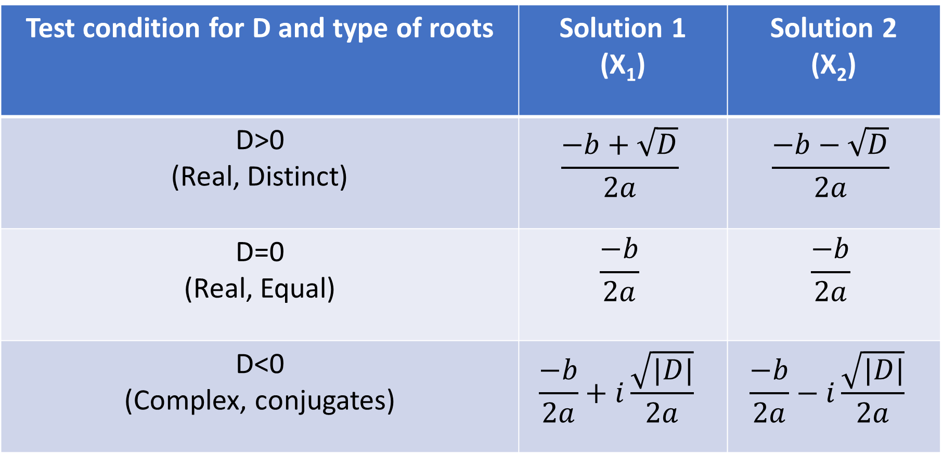
The type of solutions of the quadratic equation is purely determined by the Value of D as per the below table
Test condition for D and type of roots | Solution 1 (X₁) | Solution 2 (X₂)
D>0 (Real, Distinct) | $$\frac{−b+\sqrt{D}}{2a}$$ | $$\frac{−b−\sqrt{D}}{2a}$$
D=0 (Real, Equal) | $$\frac{−b}{2a}$$ | $$\frac{−b}{2a}$$
D<0 (Complex, conjugates) | $$\frac{−b}{2a}+i\frac{\sqrt{|D|}}{2a}$$ | $$\frac{−b}{2a}−i\frac{\sqrt{|D|}}{2a}$$

Slide 18
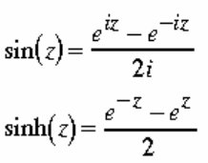
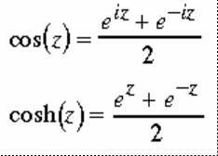
7 Supplement (Hyperbolic functions)
Essentially complex forms of trigonometric functions
Let Z be any number (complex or real)
The relation between the trigonometric and hyperbolic functions are given below.
🔍Try to derive the following relations
Cosh(i.Z) = Cos(Z)
Sinh(i.Z) = i.Sin(Z)
i.Sin(i.Z) = Sinh(Z)
Cos(i.Z) = Cosh(Z)

Slide 19
Thank you
Shreyas M
B.Tech in ECE PES University Bangalore

